Slide 1
PSPACE

Slide 2


Space Complexity
How much space is required to solve 3-SAT?
Linear, since you need to remember the current truth assignment.
How much space is required to verify a 3-SAT solution?
Seems like it would be about the same.
PSPACE is the class of problems that can be solved with a polynomial amount of space on a deterministic TM.
NPSPACE is the class of problems that can be verified with a polynomial amount of space.
The obvious question is, does PSPACE = NPSPACE?

Slide 3
Savitch’s Theorem
Savitch’s Theorem states that if a problem can be verified with f(n) space, then it can be solved with f²(n) space.
This is (and was) a shocking result that asserts PSPACE = NPSPACE!

Slide 4
What we know
P ⊆ NP
NP ⊆ PSPACE
Because NP ⊆ NPSPACE
PSPACE = NPSPACE
PSPACE ⊆ EXPTIME
There are an exponential number of configurations when restrained by polynomial space.
P ≠ EXPTIME
Most researchers think P ⊊ NP ⊊ PSPACE ⊊ EXPTIME

Slide 5
Complexity Classes
Decidable
EXPTIME
EXPTIME
PSPACE
NP
P

Slide 6
PSPACE-Complete
A language B is PSPACE-Complete if it satisfies both conditions:
B ∈ PSPACE
∀x ∈ PSPACE, x ≤_{P} B
We still use poly-time reductions. One could imagine constructing a more powerful type of reduction and using that instead.
This is unnecessarily complicated. Poly-time reductions are intuitive.
If P=NP (which has not been disproven), there wouldn’t even be a difference between these two types of reductions.
Such a reduction would not help us prove that P ≠ PSPACE, which is an easier result than showing NP ≠ PSPACE

Slide 7
A PSPACE-Complete Problem
A fully-quantified Boolean formula is a Boolean formula (such as (x ∨ y) ∧ (¬x ∨ ¬y)) preceded by quantifiers for all variables.
E.g., ∀x∃y((x ∨ y) ∧ (¬x ∨ ¬y)). Is this formula true?
Yes: when x = true, y = false. When x = false, y = true.
The True Quantified Boolean Formula problem (TQBF) is defined:
TQBF = {⟨φ⟩ | φ is a true fully-quantified Boolean formula}
TQBF is our first PSPACE-Complete problem. We will not prove it, but the proof looks pretty similar to the Cook-Levin Theorem (take CSCI 475 for details).

Slide 8
TQBF ∈ PSPACE
Do a recursive DFS through all possible variable assignments.
If your current quantifier is ∀, return true if both T and F work, otherwise return false (to the previous level of recursion).
If your current quantifier is ∃, return false if either T or F work, otherwise return true (to the previous level of recursion).
This requires a linear amount of stack space.
∀x∃y((x ∨ y) ∧ (¬x ∨ ¬y))
For x = true, recursively call your function. If your recursive call returns false, you return false. Otherwise, for x = false, recursively call your function, and you return whatever the recursive call returns.
In the recursive call, for y = true, evaluate the formula. If it evaluates to true, you return true. Otherwise, for y = false, you return whatever the formula evaluates to.

Slide 9

The Formula Game
You are given a fully-quantified Boolean formula φ.
There are two players: Player A and Player E.
Play order proceeds via the order of the quantifiers in φ.
Every time you see ∀x, player A gets to choose the value of x.
Every time you see ∃y, player E gets to choose the value of y.
After all moves have been made, remove the quantifiers, and apply the chosen values to each variable.
A wins if the formula evaluates to false.
E wins if the formula evaluates to true.

Slide 10
An Example Game
∀x ∃y ∃z [(x ∨ y) ∧ (y ∨ z) ∧ (¬y ∨ ¬z)]
Player A sets x = False
Player E sets y = True
Player E sets z = False
The formula evaluates to True, so player E wins.
If Player A had set x = True, the same moves by Player E would lead to Player E winning.
Player E has a winning strategy on this formula.

Slide 11
An Example Game
∃x ∀y ∃z [(x ∨ y) ∧ (y ∨ z) ∧ (y ∨ ¬z)]
Who has the winning strategy?
Player A does.
When y = True, player E can’t make both the 2nd and 3rd clause true.
What kind of formula lead to player A having a winning strategy?
Any formula that is false. Since there formula is false, there must be choices of the ∀ variables that evaluate to false, regardless of the choices of the ∃ variables.
Similarly, player E has a winning strategy whenever the formula is true. No matter what choice player A makes, player E should be able to find values for the ∃ variables that satisfy the formula.
Therefore, this game is PSPACE-Complete, as it is literally the TQBF problem.
Most PSPACE-Complete problems are “games”.

Slide 12
The Game of Geography
In the game of Geography, players take turns naming cities from anywhere in the world.
Each city’s first letter must be the same as the last letter of the previous city named.
Once a city has been named, it can never be used again.
You can treat this as a graph problem.
Peoria
Albany
Orsay
Austin
Nashua
Oakland
Tokyo
Amherst
Tucson

Slide 13
Generalized Geography
In the Generalized Geography game (GG), you are given a directed graph with a designated start node.
Players alternate moving a token along an edge to form a path (you can’t repeat nodes).
If a player cannot make a move, that player loses.
GG will be our next PSPACE-Complete problem!
Most PSPACE-Complete problems are games where you try and figure out who has the winning strategy.
Chess, Checkers, and Go are on constant-sized boards, but if you generalize them to n × n boards, they are all PSPACE-Complete, or harder.

Slide 14
An Example
Who has a winning strategy?
Player 1: move 3, then 6.
What if we reverse edge (3,6)?
Player 2 wins.
If Player 1 goes to 3, Player 2 goes to 6. Player 2 wins.
If Player 1 goes to 2, Player 2 goes to 4.
If Player 1 goes to 5, Player 2 goes to 6. Player 2 wins.
If Player 1 goes to 7, Player 2 goes to 9. Player 2 wins.
4
7
9
2
5
8
1
3
6

Slide 15
GG ∈ PSPACE
Given a graph G and start node b:
Our algorithm will accept if Player 1 wins and reject if Player 2 wins.
If b has out-degree 0, reject.
Remove b, and all of it’s outgoing edges.
For each node b_{i} that had an edge from b:
Recursively call our algorithm, with start node b_{i}.
We have swapped players with this recursive call, so we will invert the output.
If our recursive call rejects (there is a good outcome for Player 1), then accept.
Reject (all paths lead to a bad outcome for Player 1).

Slide 16
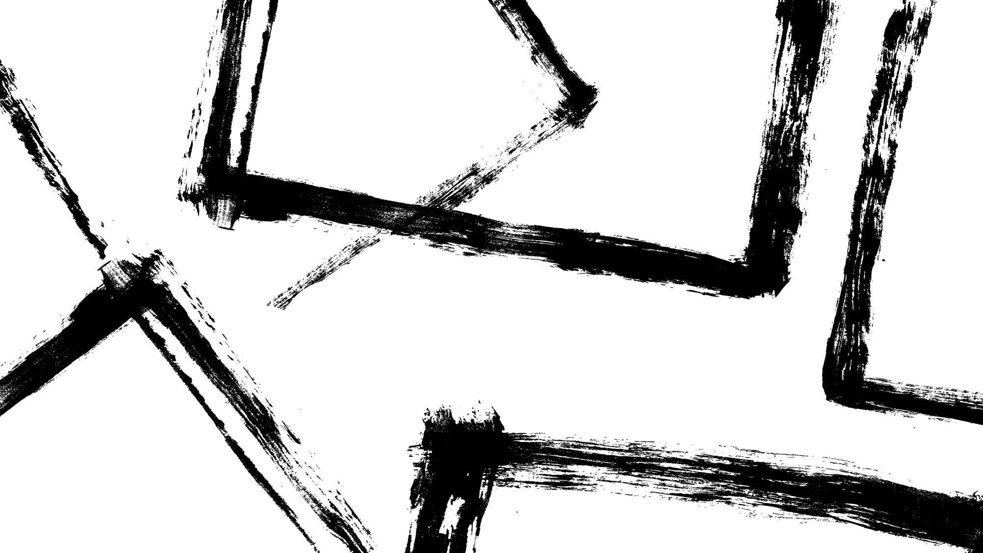
GG is PSPACE-Complete
Reduce from the Formula Game.
We will assume our input formula starts and ends with ∃, and alternates between ∃ and ∀.
We can make our formula conform to this by adding extra quantifiers that bind unused “dummy” variables.
We will assume the formula is in Conjunctive Normal Form.
Any Boolean formula can be transformed to CNF.
Player E will be Player 1, and Player A will be Player 2.

Slide 17
GG is PSPACE-Complete, Part 2
b
x₁
Player 2 chooses the clause that is false.
Player 1 chooses the variable that actually makes that clause true.
Player 1 (Player E) wins if the formula is true.
x₁
¬x₁
¬x₂
c₁
x₂
¬x₂
¬x_{n}
c
…
¬x₁
…
x_{n}
¬x_{n}
c_{m}

